Slide 1
Sets

Slide 2
Sets
Set is a collection of items. Let me take you back to your elementary or high school Mathematics lesson. The Mathematics definition of a set can be applied also in Python. Set is a collection of unordered and un-indexed distinct elements. In Python set is used to store unique items, and it is possible to find the union, intersection, difference, symmetric difference, subset, super set and disjoint set among sets.

Slide 3
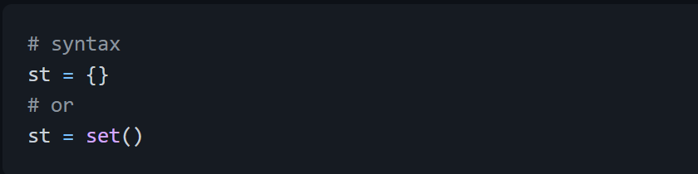
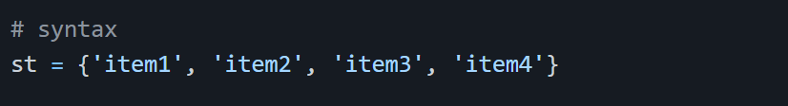
Creating a Set
We use curly brackets, {} to create a set or the set() built-in function.
Creating an empty set
Creating a set with initial items

Slide 4
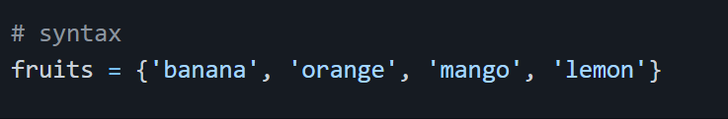
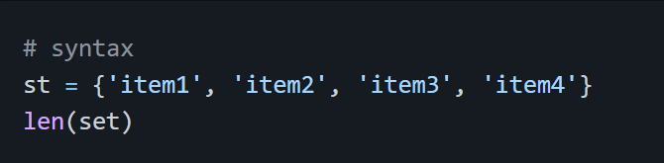
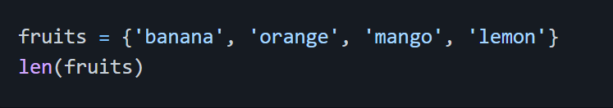
Example:
Getting Set's Length:
We use len() method to find the length of a set.
Example:

Slide 5
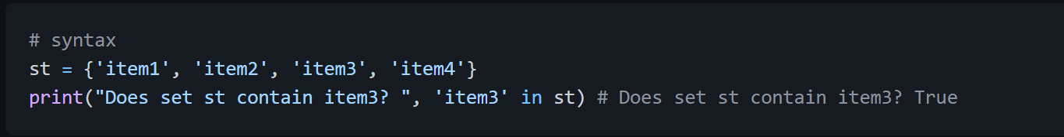
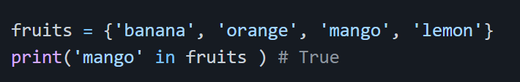
Accessing Items in a Set
We use loops to access items. We will see this in loop section
Checking an Item:
To check if an item exist in a list we use in membership operator.
Example:

Slide 6
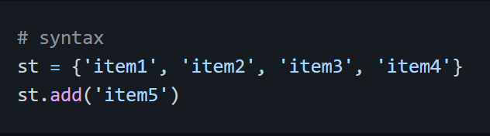
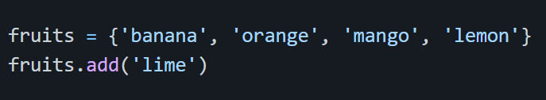
Adding Items to a Set
Once a set is created we cannot change any items and we can also add additional items.
Add one item using add()
Example:

Slide 7
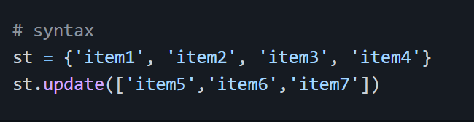
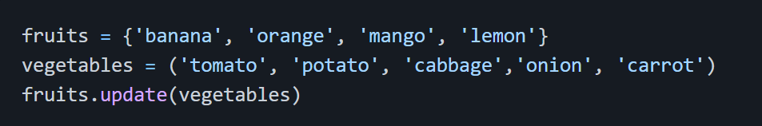
Add multiple items using update() The update() allows to add multiple items to a set. The update() takes a list argument.
Example:

Slide 8
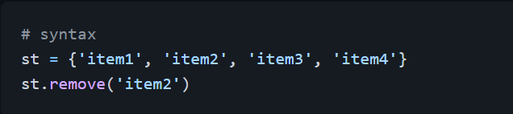
Removing Items from a Set
We can remove an item from a set using remove() method. If the item is not found remove() method will raise errors, so it is good to check if the item exist in the given set. However, discard() method doesn't raise any errors.
The pop() methods remove a random item from a list and it returns the removed item.

Slide 9
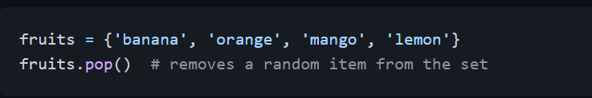
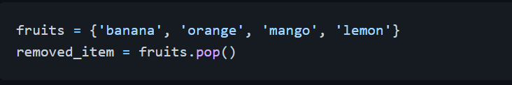
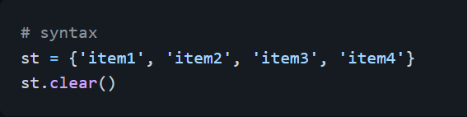
Example:
If we are interested in the removed item.
Clearing Items in a Set
If we want to clear or empty the set we use clear method.

Slide 10
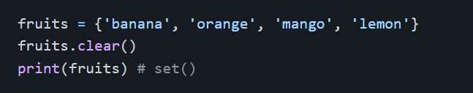
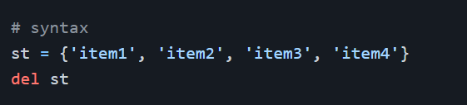
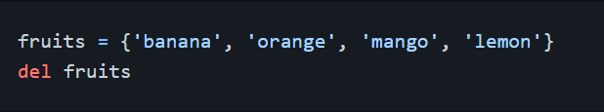
Example:
Deleting a Set
If we want to delete the set itself we use del operator.
Example:

Slide 11
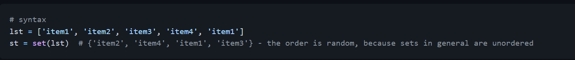
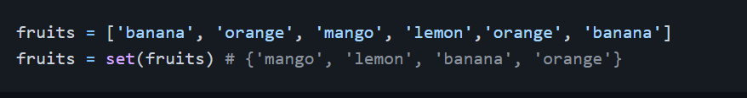
Converting List to Set
We can convert list to set and set to list. Converting list to set removes duplicates and only unique items will be reserved.
Example:

Slide 12
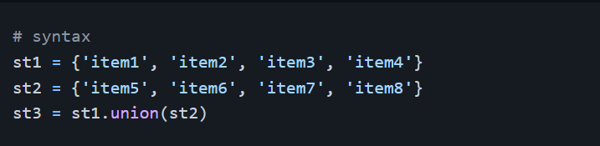
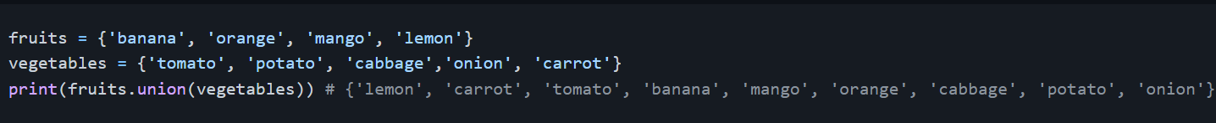
Joining Sets
We can join two sets using the union() or update() method.
Union This method returns a new set
Example:

Slide 13
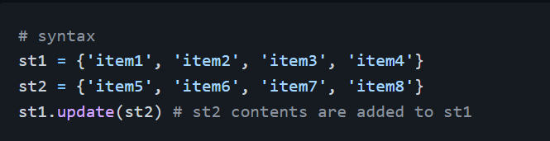
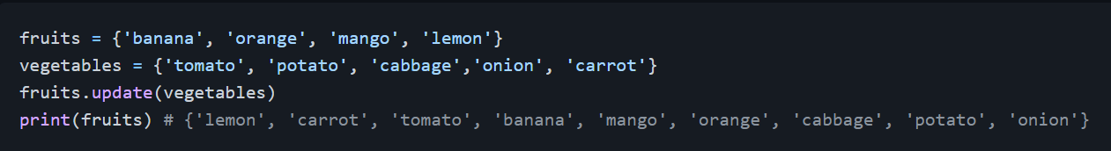
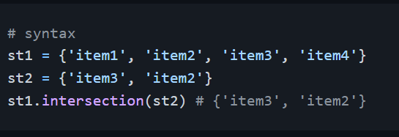
Update This method inserts a set into a given set
Example:
Finding Intersection Items
Intersection returns a set of items which are in both the sets. See the example

Slide 14
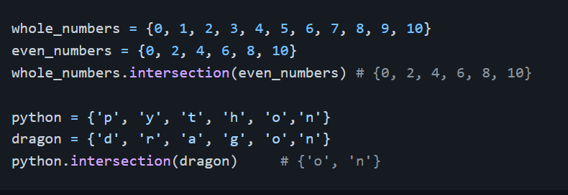
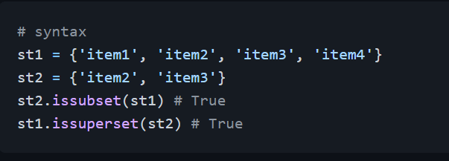
Example:
Checking Subset and Super Set
A set can be a subset or super set of other sets:
Subset: issubset()
Super set: issuperset

Slide 15
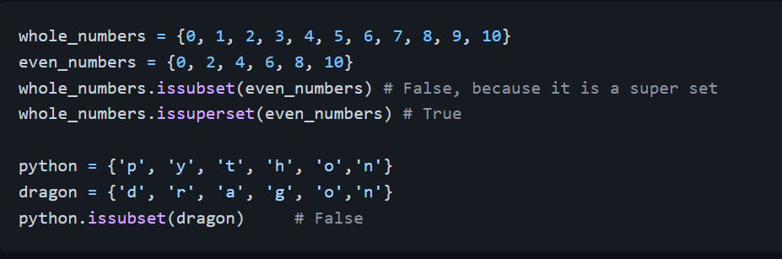
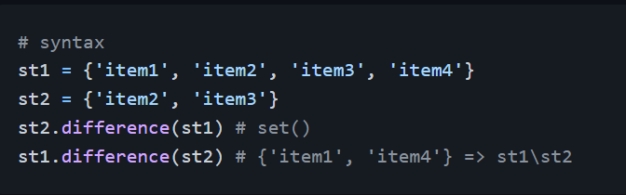
Example:
Checking the Difference Between Two Sets
It returns the difference between two sets.

Slide 16
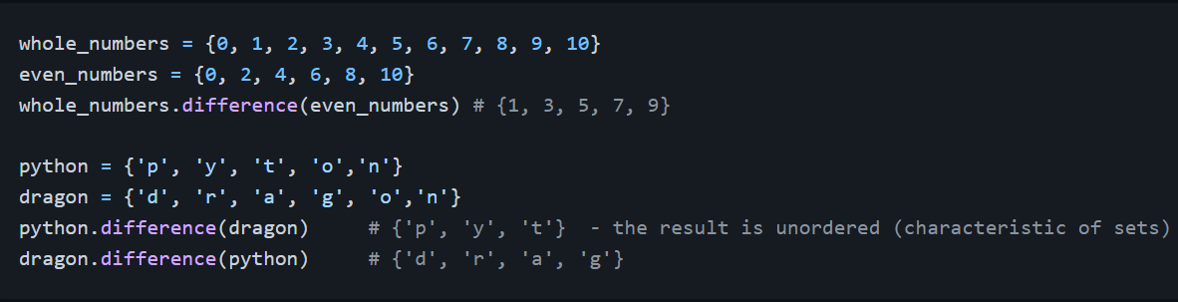
Example:

Slide 17
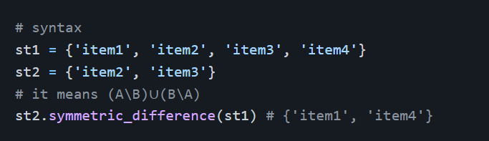
Finding Symmetric Difference Between Two Sets
It returns the the symmetric difference between two sets. It means that it returns a set that contains all items from both sets, except items that are present in both sets, mathematically: (A\B) ∪ (B\A)

Slide 18
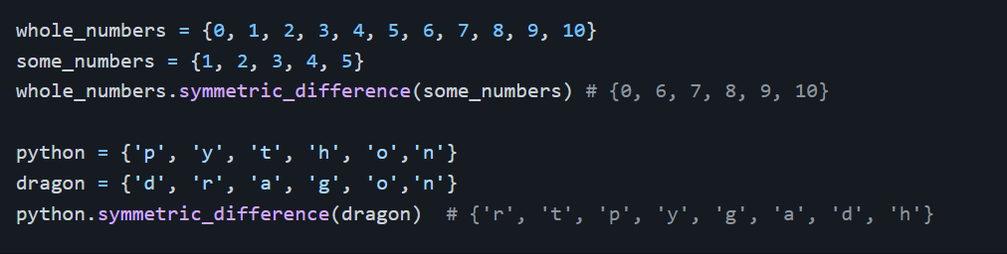
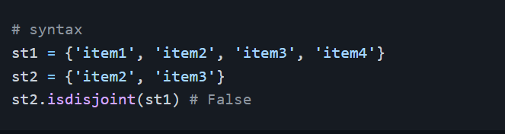
Example:
Joining Sets
If two sets do not have a common item or items we call them disjoint sets. We can check if two sets are joint or disjoint using isdisjoint() method.

Slide 19
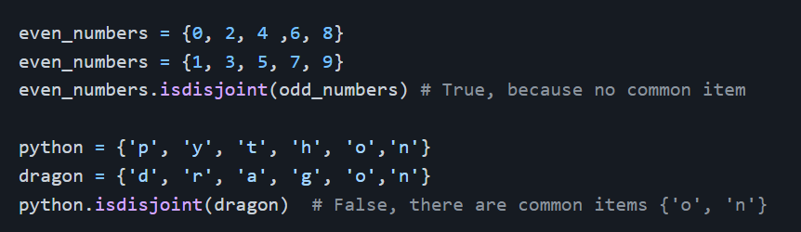
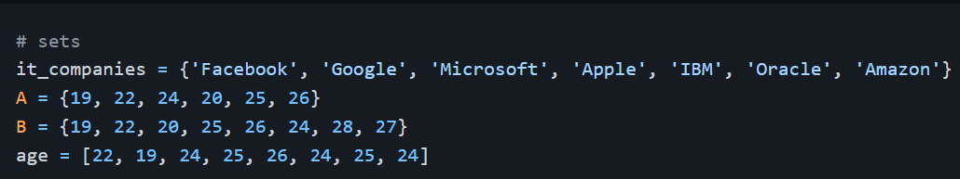
Example:
Exercises: Day 7

Slide 20
Exercises: Level 1
Find the length of the set it_companies
Add 'Twitter' to it_companies
Insert multiple IT companies at once to the set it_companies
Remove one of the companies from the set it_companies
What is the difference between remove and discard

Slide 21
Exercises: Level 2
Join A and B
Find A intersection B
Is A subset of B
Are A and B disjoint sets
Join A with B and B with A
What is the symmetric difference between A and B
Delete the sets completely

Slide 22
Exercises: Level 3
Convert the ages to a set and compare the length of the list and the set, which one is bigger?
Explain the difference between the following data types: string, list, tuple and set
I am a teacher and I love to inspire and teach people. How many unique words have been used in the sentence? Use the split methods and set to get the unique words.

